Slide 1
From Classroom ML to Industry Al
Building Sustainable, Responsible, and Community-Centric Intelligence
MIT Arts, Commerce & Science College
Mayur Madnani

Slide 2
THE REALITY CHECK

Slide 3
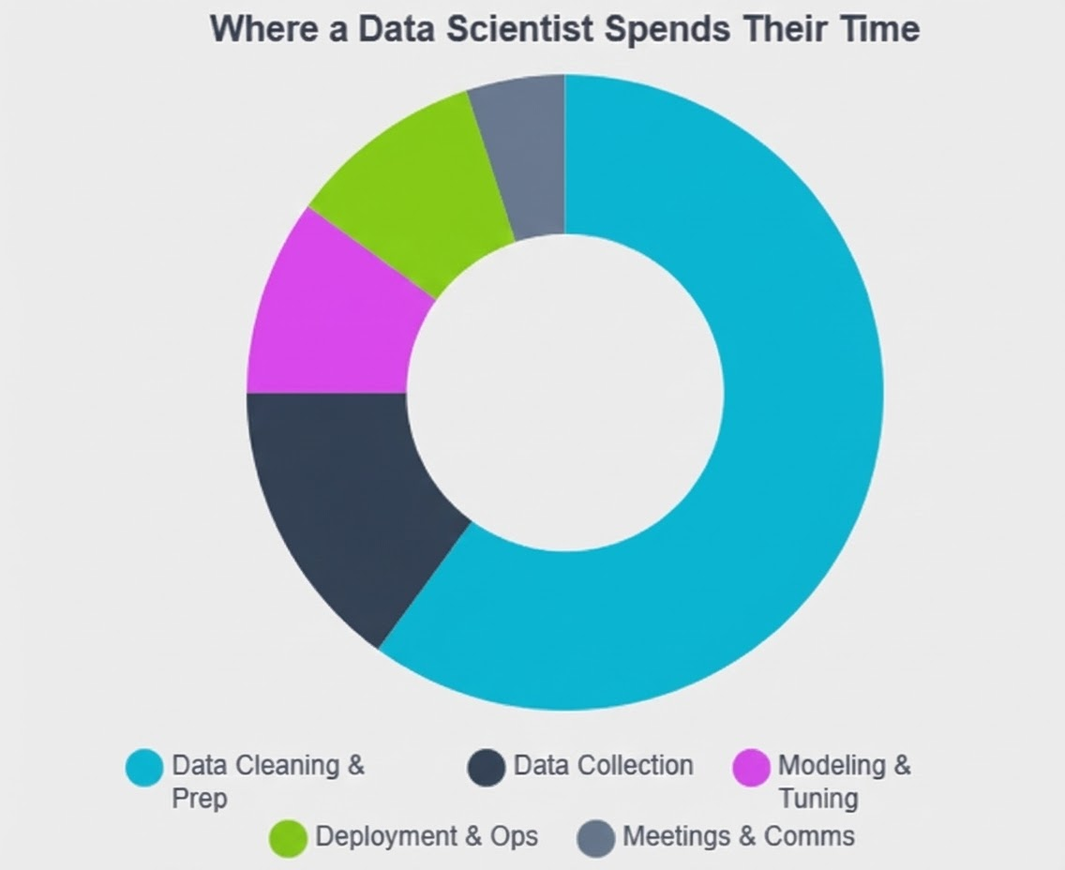
The 80/20 Reality

Slide 4
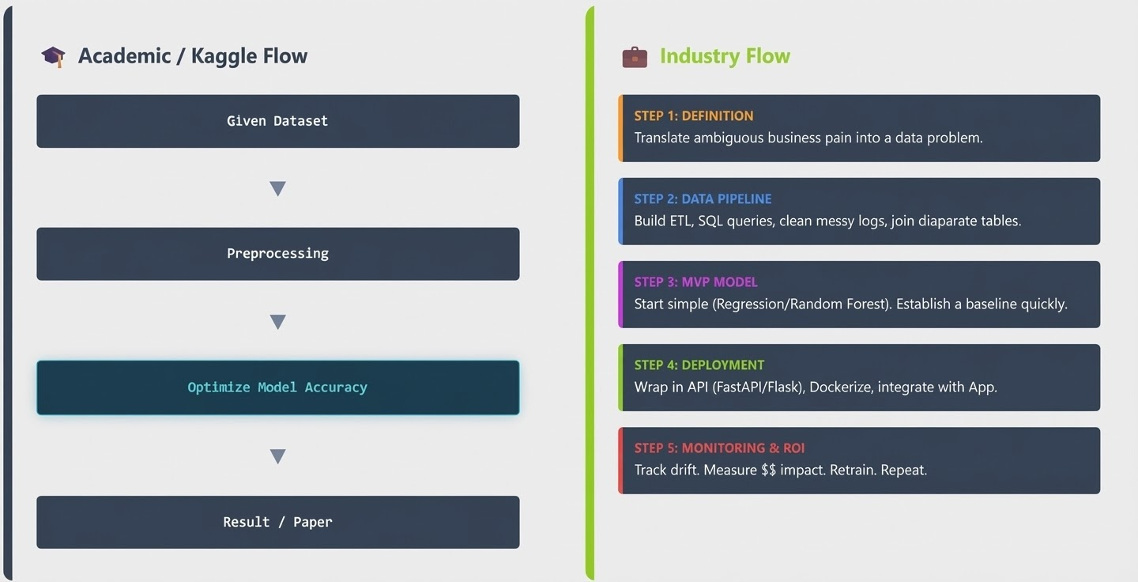

Slide 5
Criteria | Academic Context | Industrial Context
Success Metric | Accuracy, F1-Score, Log-Loss. | ROI, Customer Churn Reduction, Latency (ms), Uptime.
Scalability | Works on a laptop/Colab (small batch). | Scales to millions of requests/day; handles concurrency.
Latency | Irrelevant; batch processing is acceptable. | Critical; real-time inference often required (<100ms).
Maintenance | None; code is archived after publication. | Continuous; CI/CD pipelines, drift detection, on-call rotation.
Code Quality | "Spaghetti code" acceptable if results are correct. | Modular, tested, documented, compliant with linting standards.

Slide 6
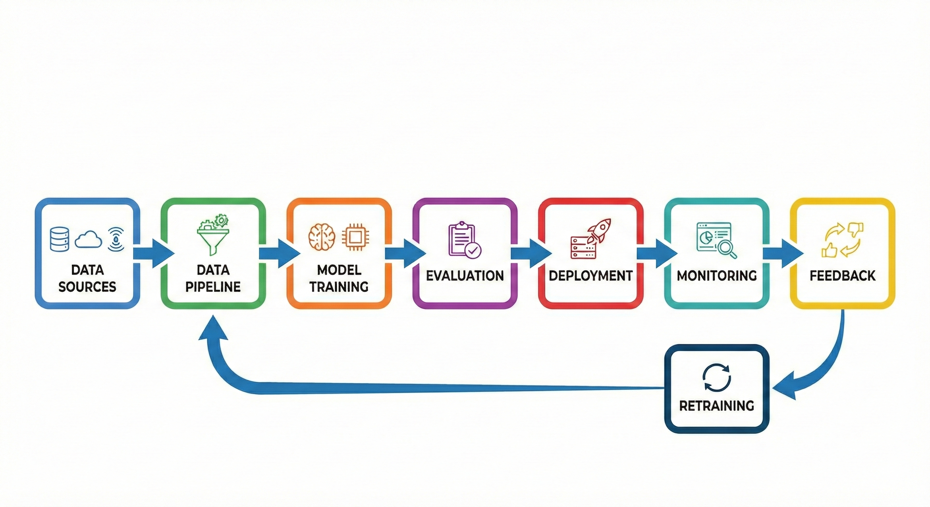
The Lifecycle

Slide 7
Career Options
1] The Foundational Triad: Scientist, Engineer, Analyst
1.1 The Data Scientist: The Scientific Problem Solver
1.2 The Data Engineer: The Infrastructure Architect
1.3 The Data Analyst: The Business Intelligence Strategist
2] The Emerging AI Specialists
2.1 Machine Learning Engineer (MLE): The Productionizer
2.2 Generative AI Engineer: The Creator
2.3 Agentic AI Engineer: The Orchestrator

Slide 8
The AI Landscape

Slide 9
# 1
# 2
# 3
# 4
Rules-Based AI
Deterministic logic
Hand-crafted, predefined rules
Task-specific automation
Minimal adaptability and learning
Machine Learning
Learns patterns from data
Statistical modeling and optimization
Prediction and classification
Improves performance with experience
Generative AI
Creates text, images, code, and media
Trained on large-scale data
Context-aware and conversational
Produces human-like outputs
Agentic AI
Autonomous
Interacts with tools and environments
Continuously learns and adapts
Perceive - Reason - Act - Learn
https://ourworldindata.org/brief-history-of-ai
https://r0bk.github.io/killedbyllm/

Slide 10
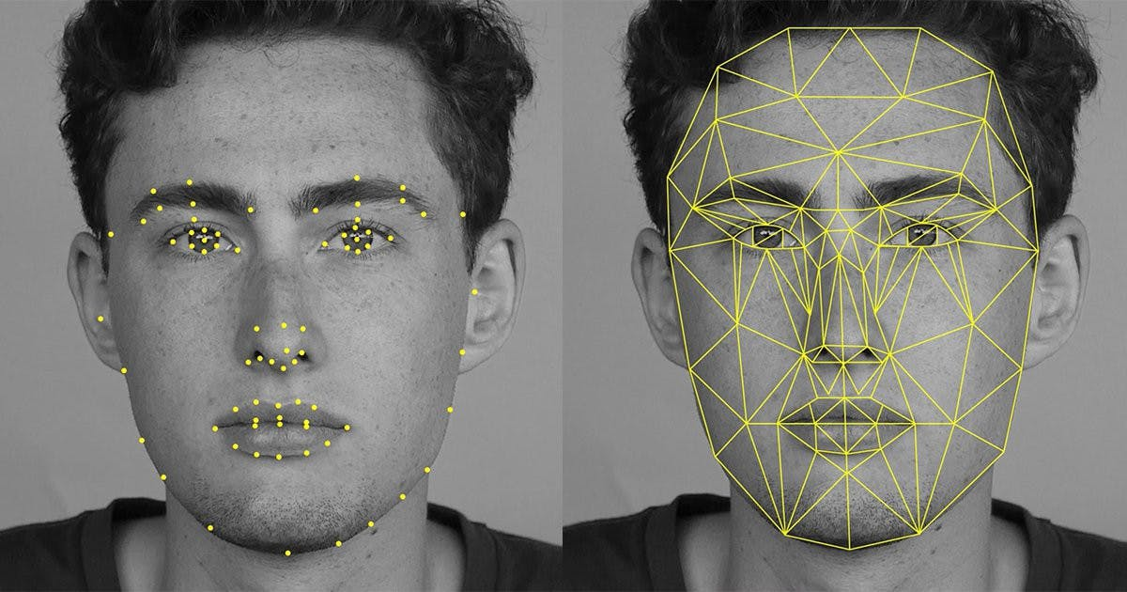
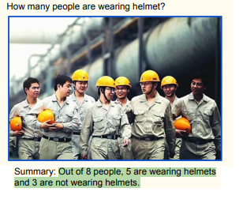
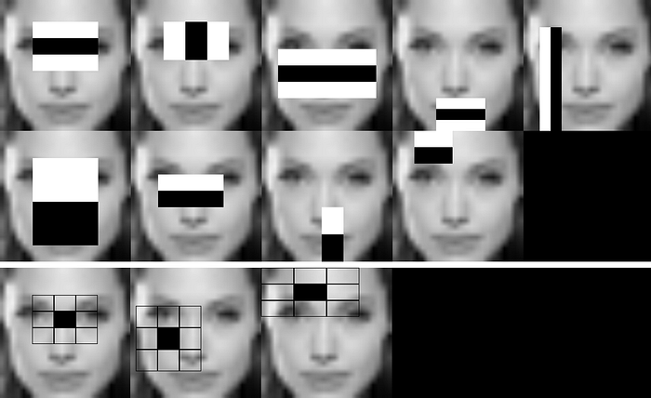
Evolution- Face Detection
Deep Learning
Generative AI
Computer Vision

Slide 11
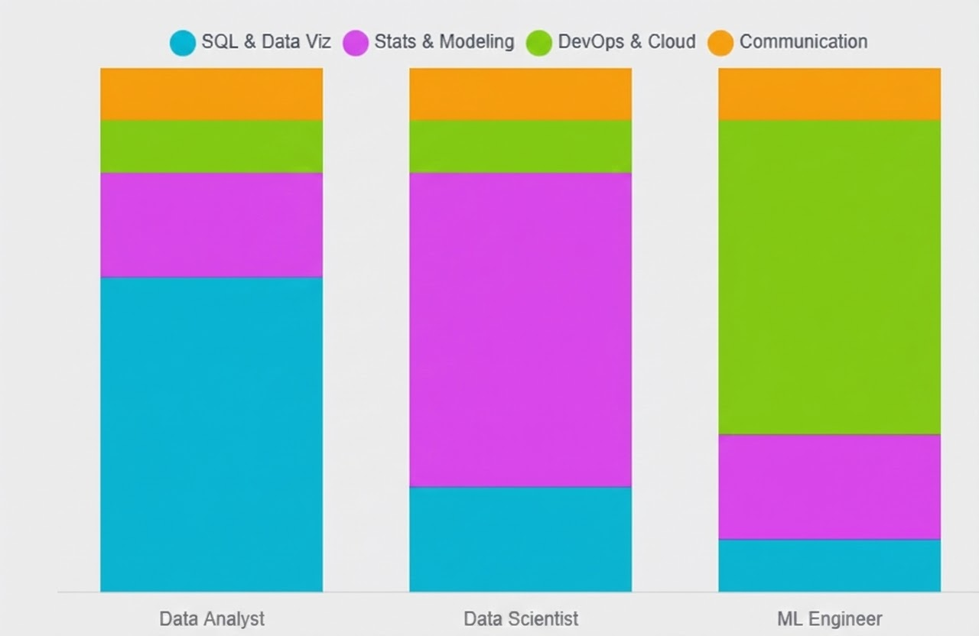
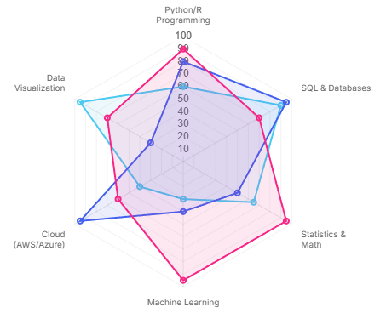
Skills
Why do we see “Data Analysis” as an important skill in all the roles

Slide 12



Understanding Customer Habits

Slide 13
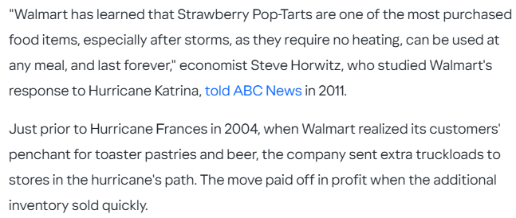
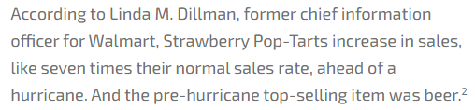
Understanding Customer Habits

Slide 14
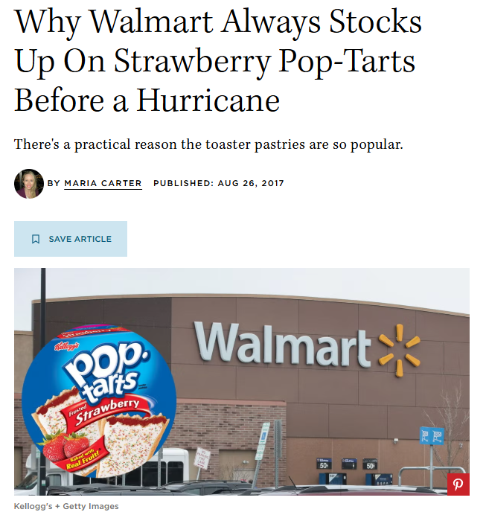

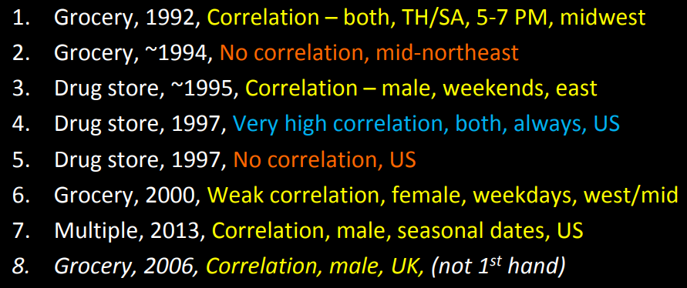
https://www.countryliving.com/food-drinks/a44550/walmart-strawberry-pop-tarts-before-hurricane
https://download.1105media.com/tdwi/Remote-assets/Events/2017/Boston/MarkMadsen_Beer-and-Diapers.pdf

Slide 15
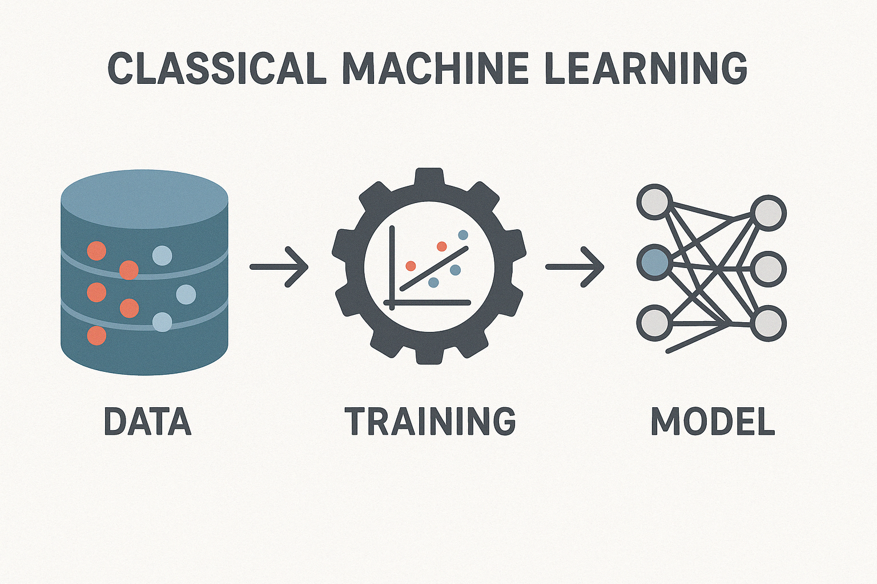
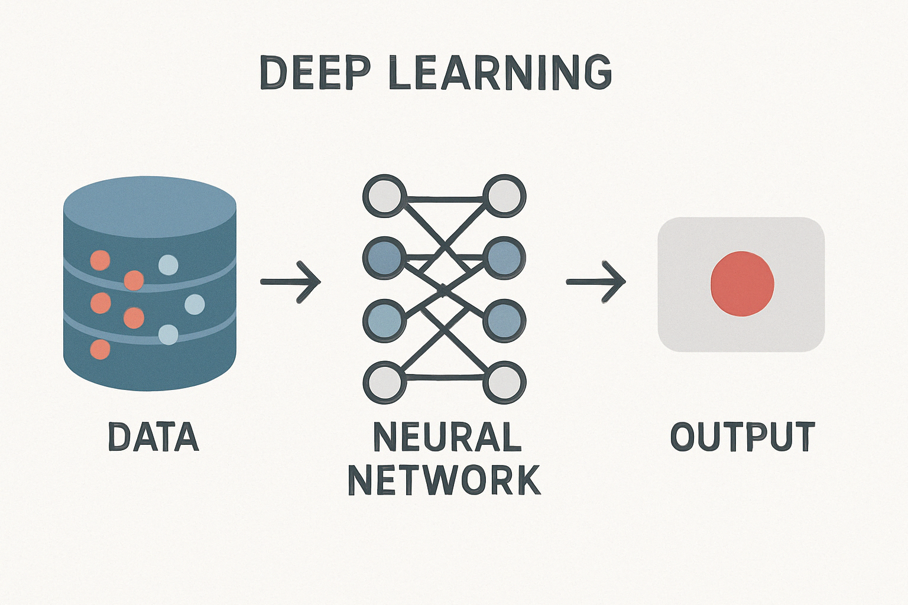
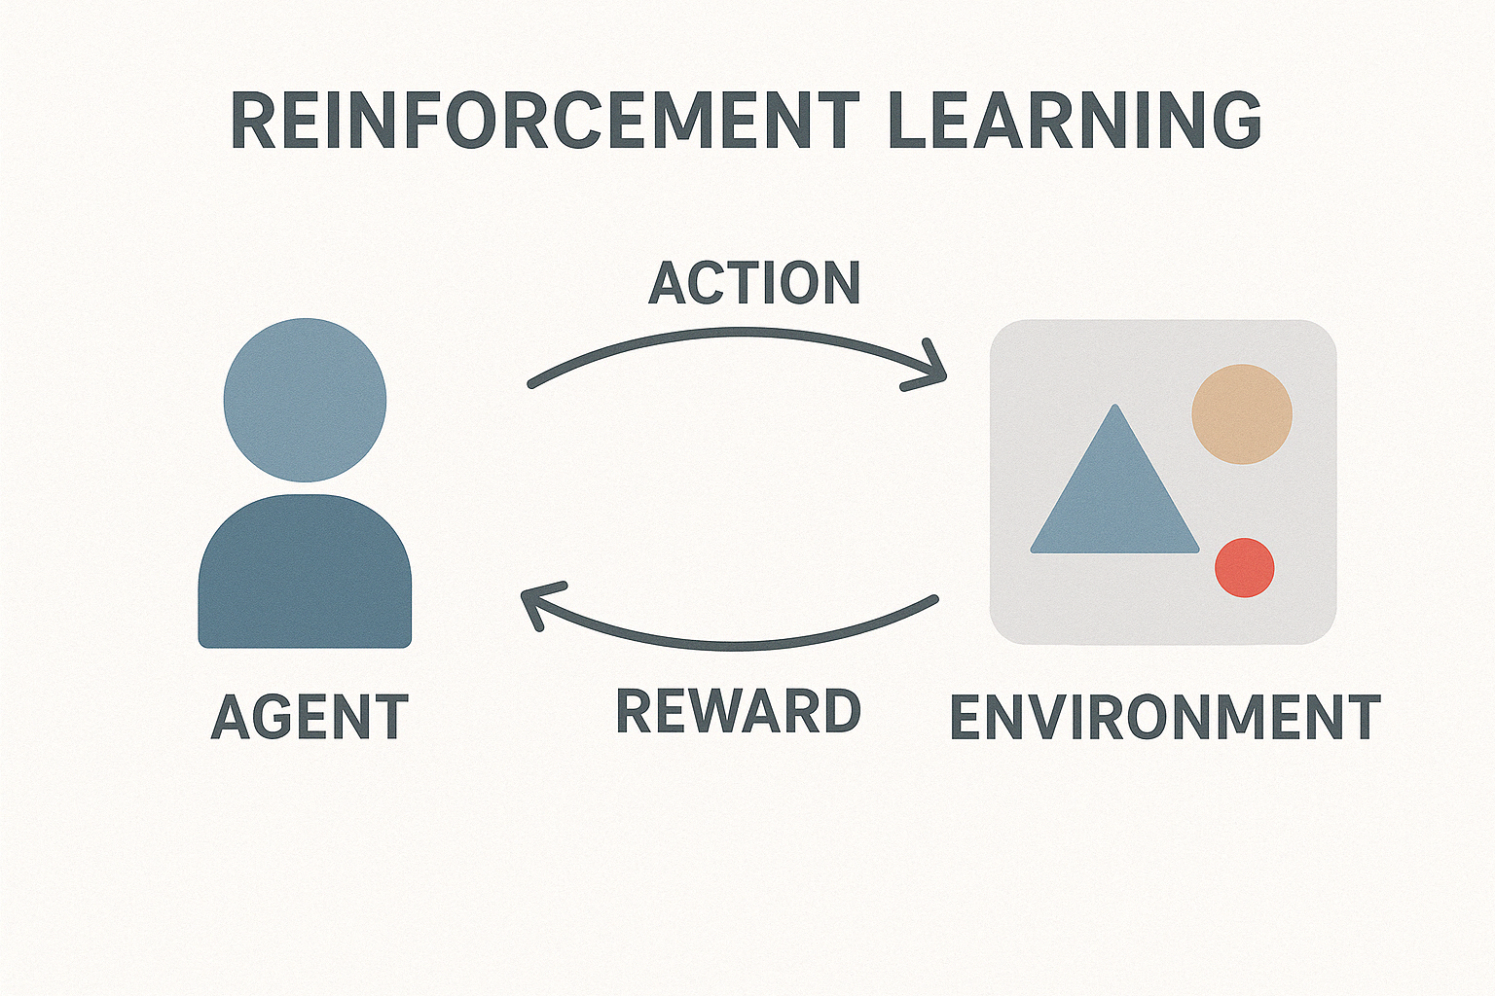
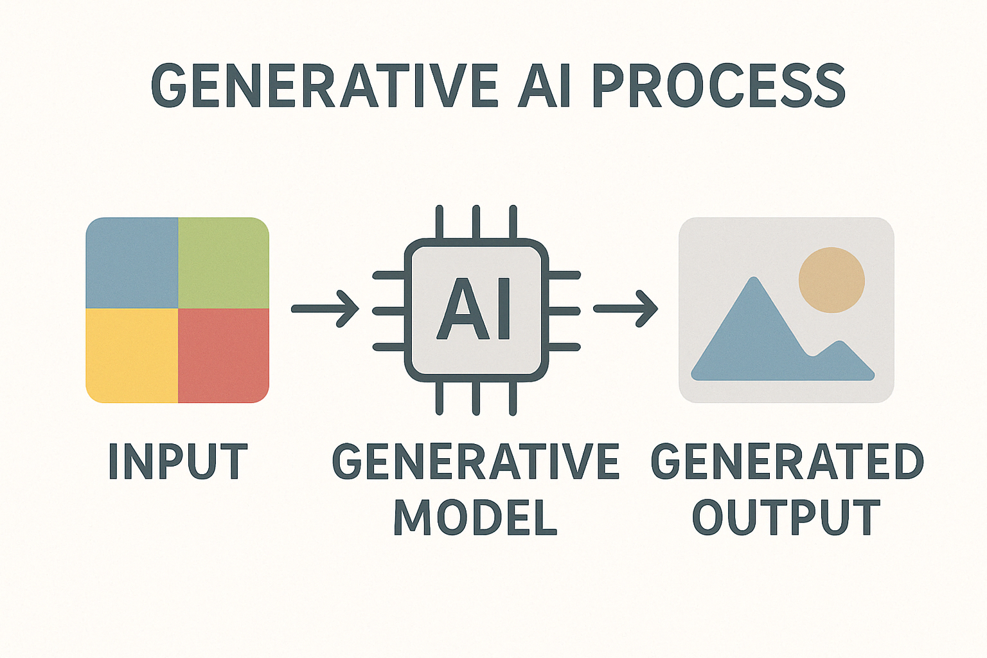
https://seaborn.pydata.org/examples/index.html
https://scikit-learn.org/stable/auto_examples/index.html

Slide 16
Demo

Slide 17
https://poloclub.github.io/cnn-explainer/
https://cs.stanford.edu/people/karpathy/convnetjs/demo/mnist.html

Slide 18
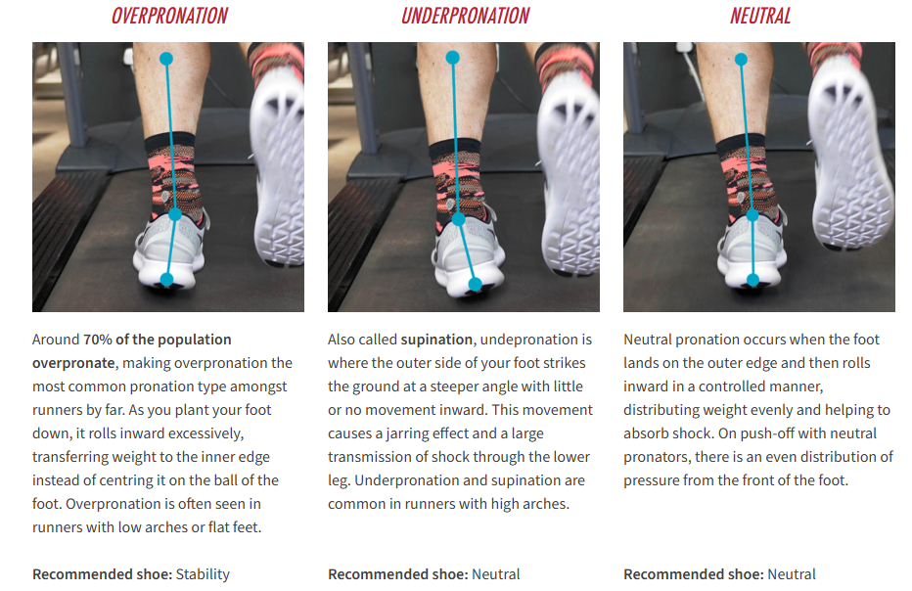
GAIT Analysis
https://www.runnersneed.com/expert-advice/gear-guides/gait-analysis.html

Slide 19
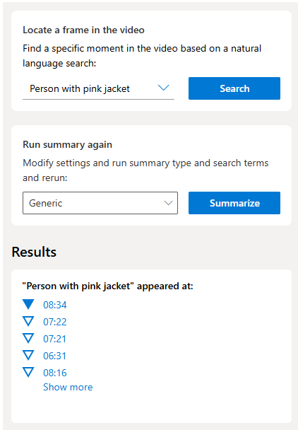
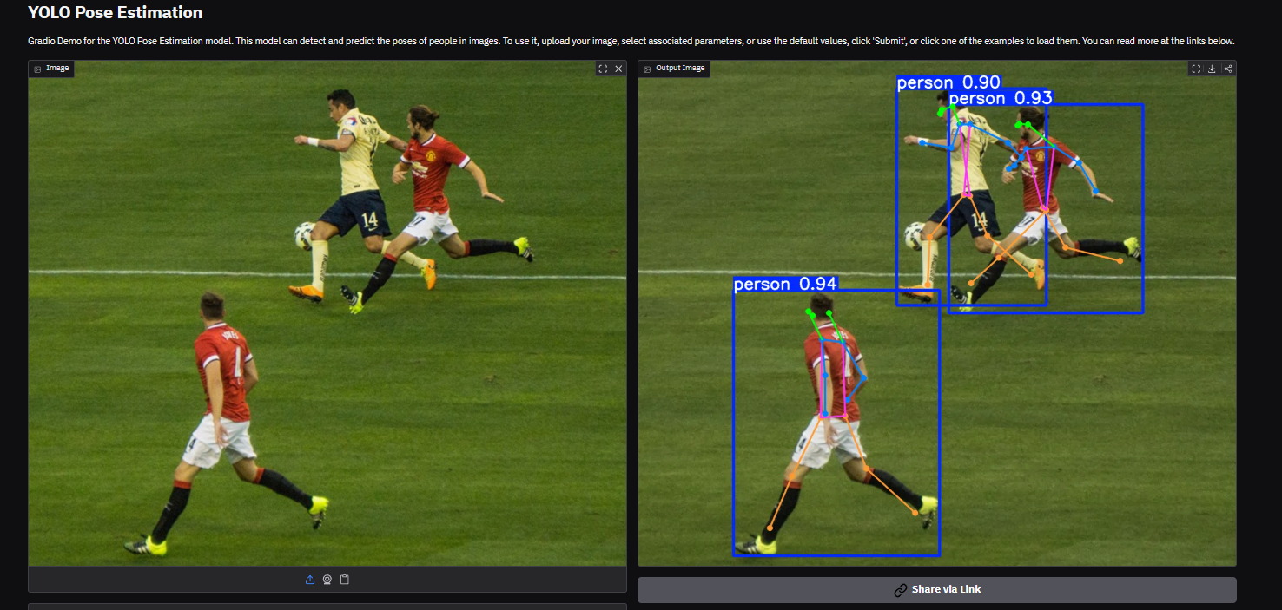
Pose Detection
https://huggingface.co/spaces/sitammeur/YoloPose
https://preview.vision.cognitive.azure.com/demo/video-summary-and-frame-locator

Slide 20
https://developmentalsystems.org/Interactive_DeepRL_Demo

Slide 21

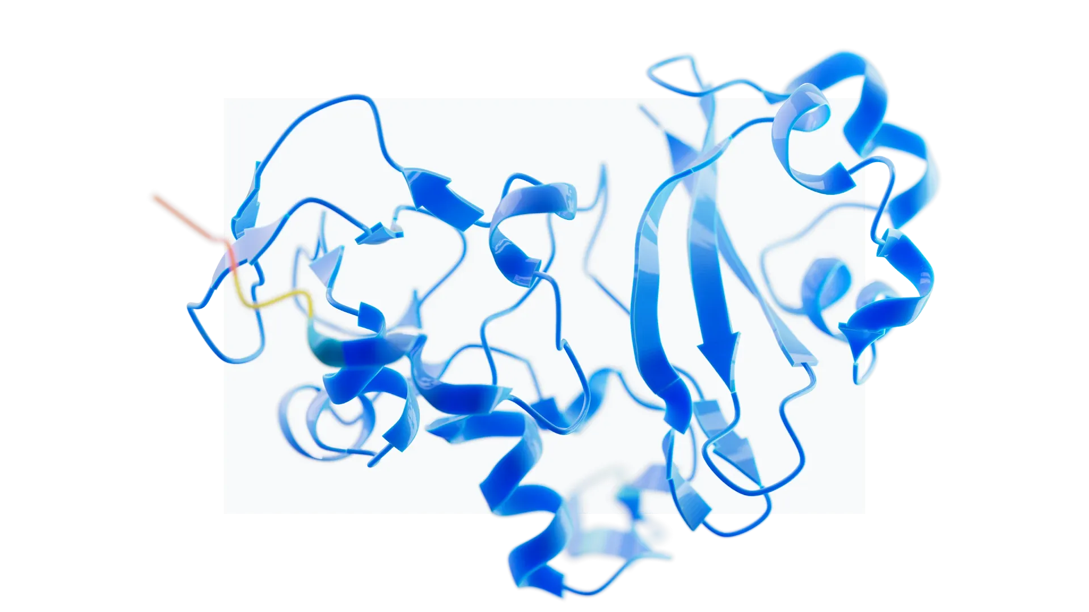
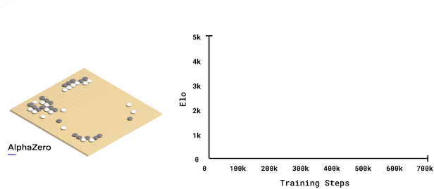
Reinforcement Learning
https://deepmind.google/research/breakthroughs/alphago/
https://deepmind.google/discover/blog/alphazero-shedding-new-light-on-chess-shogi-and-go/
https://deepmind.google/technologies/alphafold/

Slide 23
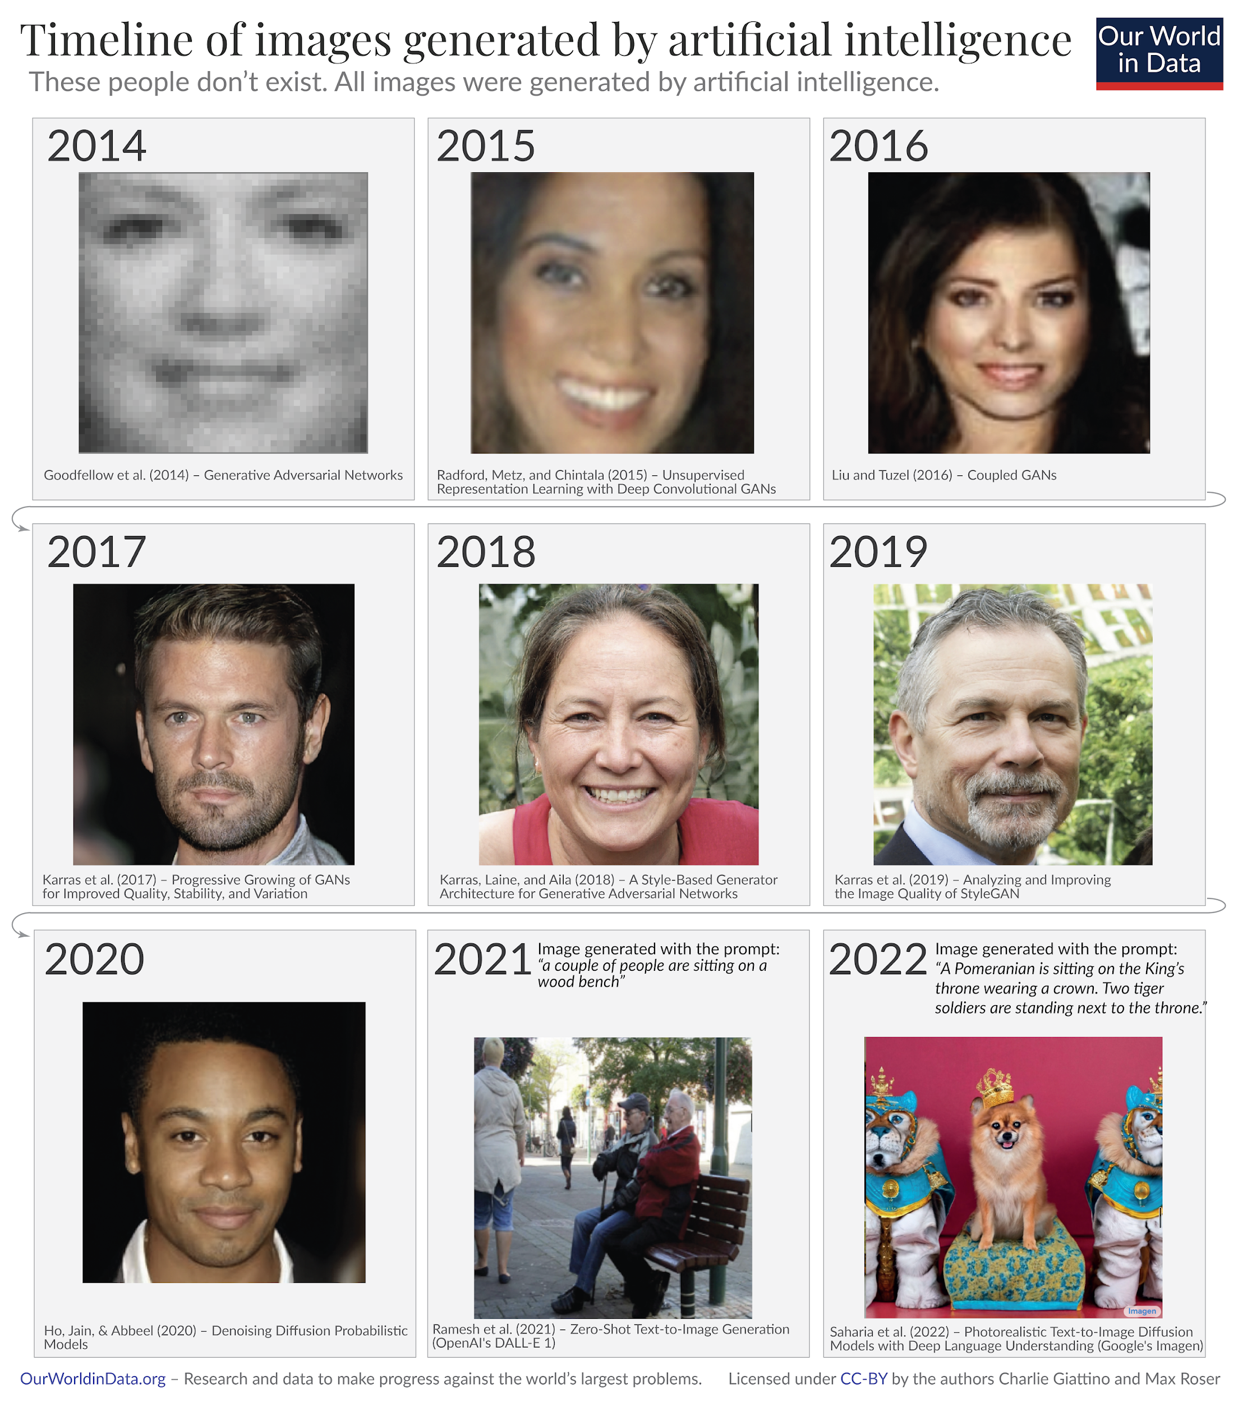
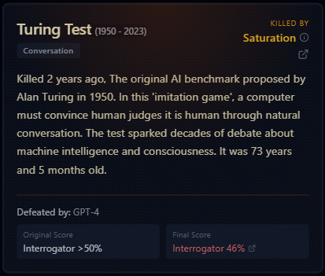
https://ourworldindata.org/brief-history-of-ai
https://r0bk.github.io/killedbyllm/

Slide 24
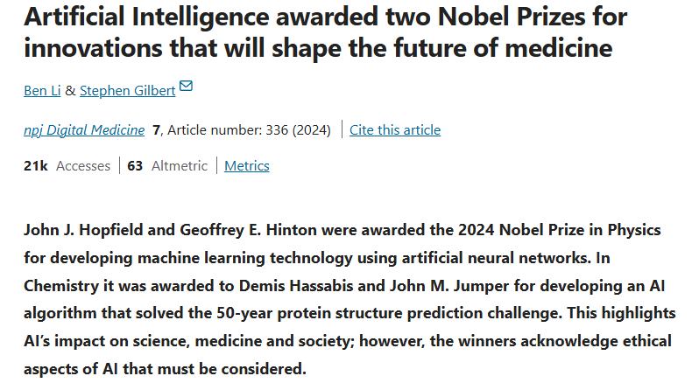

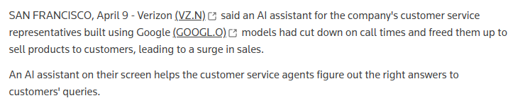
https://www.nature.com/articles/s41746-024-01345-9
https://adage.com/article/marketing-news-strategy/new-barbie-packaging-was-made-adobe-ai-tool/2586391/
https://www.reuters.com/technology/verizon-says-google-ai-customer-service-agents-has-led-sales-jump-2025-04-09/

Slide 25
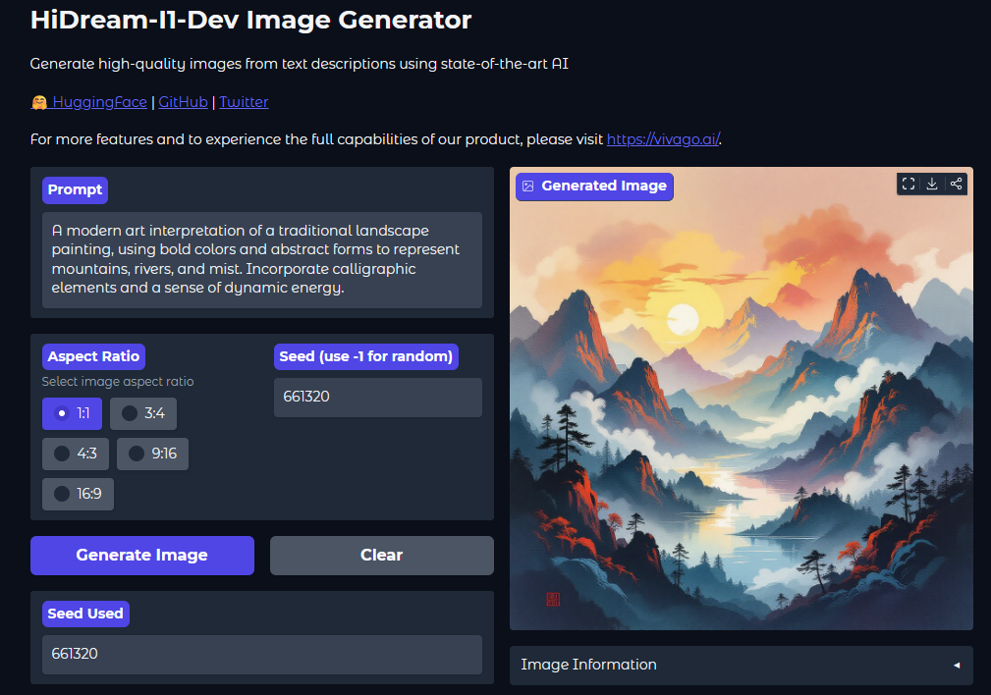
https://huggingface.co/spaces/HiDream-ai/HiDream-I1-Dev

Slide 26
https://huggingface.co/spaces/HiDream-ai/HiDream-E1.1

Slide 27

https://huggingface.co/spaces/Qwen/Qwen2.5-Coder-Artifacts

Slide 28

https://huggingface.co/spaces/enzostvs/deepsite

Slide 29
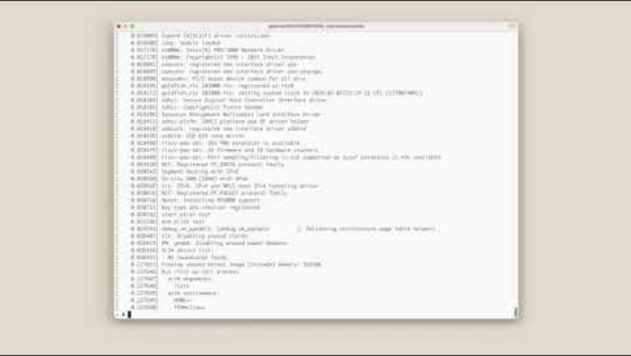
https://www.anthropic.com/engineering/building-c-compiler

Slide 30
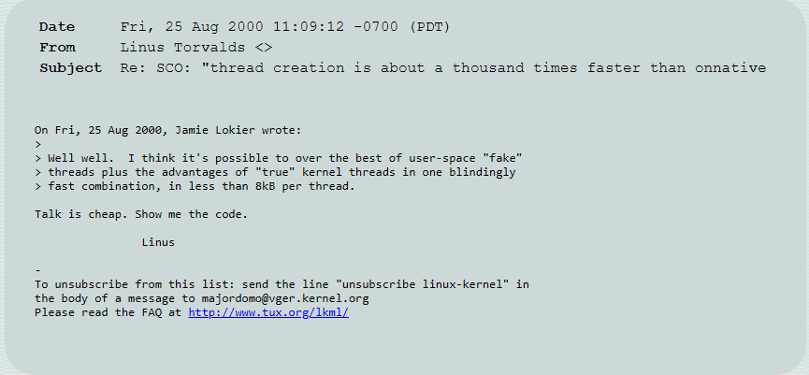
https://lkml.org/lkml/2000/8/25/132

Slide 31
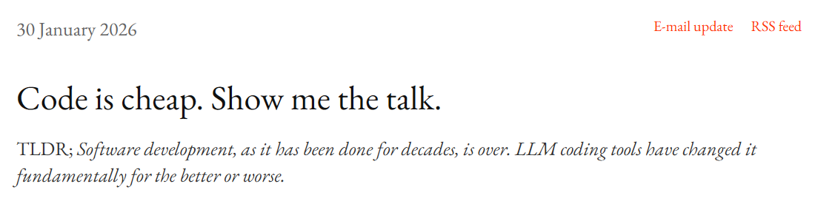
https://nadh.in/blog/code-is-cheap/

Slide 32
Green AI, SDGs, UBA

Slide 33

https://sdgs.un.org/goals

Slide 34
Green AI and the SDGs
The Green AI Solution:
Optimizing algorithms for energy efficiency. For example, using mixed-integer linear programming combined with AI in waste management has shown a 25% reduction in energy consumption during workflows.
SDG Alignment:
SDG 9 & 11: AI for smart infrastructure, urban mobility, and e-waste management.
SDG 13: Geospatial deep learning and TinyML for precision agriculture and climate modeling.

Slide 35
Unnat Bharat Abhiyan (UBA) & Applied AI
What is UBA?
A flagship national program connecting higher education institutions with rural development.
The Opportunity:
The daily challenges faced by rural communities are fundamentally complex data problems.
The Blueprint:
The exact same neural network architectures used by tech giants can be adapted to solve village-level problems. You don't need to be in a massive corporate lab to do real AI.
https://unnatbharatabhiyan.gov.in/participating-institutes
https://unnatbharatabhiyan.gov.in/uba-sanctionedletter

Slide 36
UBA Case Studies in Action
Rural Healthcare:
Utilizing Convolutional Neural Networks (CNNs) for the automated detection of cataracts and glaucoma in rural populations.
Agriculture & Environment:
Deploying IoT sensor networks (like the "CropRakshak" project) using NodeMCU hardware for live environmental data feeds.
Primary Education:
Implementing advanced spatial computing, Virtual Reality, and Augmented Reality to enhance learning outcomes for children in resource-constrained schools.

Slide 37
Leveraging Indian Open Datasets
Key Resources (IndiaAI & Data.gov.in):
Healthcare: The Oral Cancer Imaging and Clinical Dataset for training CNNs on early cancer detection.
Geospatial: 2011 Population Census district and state polygon geometries for spatial AI mapping.
Governance: Datasets tracking rural habitation and drinking water availability to cluster villages by socioeconomic vulnerability.
https://indiaai.gov.in/datasets
https://www.data.gov.in

Slide 38
Thank You!
Mayur Madnani
linkedin.com/in/mayurmadnani

